Slide 1
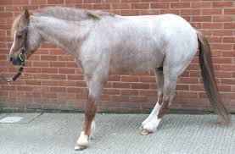
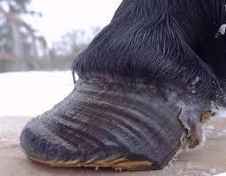
“Laminitis and your horse”
Equine Evening No 3 with Wilna
& guest speaker Hayley-Jane
from Prydes EasiFeed
Different types of laminitis and their causes,
how they can affect your horse,
what happens if they do, and
PREVENTION PREVENTION PREVENTION
Wednesday 13th February 2019
@ 7.00pm
Upstairs @ Wanganui Vet Services
35 Somme Parade
Wanganui
(Entrance off Plymouth Street)
Tea, coffee and biscuits provided
Questions will be welcomed
We look forward to seeing you there
RSVP : Please by Monday 11th February 2019
Phone : 3490155 or
Email : rh@wgvets.co.nz

